Slide 1
Ensemble 业务服务 (Business Services)

Slide 2
Ensemble 开发 业务服务(BS)
Client Applications
Inbound Adapters
Business
Services
Business
Operations
Outbound Adapters
External Applications
Business
Processes
Ensemble
Notes:
A business service accepts input from outside of Ensemble and passes the information to a business process or business operation.

Slide 3
Ensemble 开发 业务服务(BS)
业务服务是开发给外部访问Ensemble的接口.
有2种访问方式:
输入型适配器(Inbound adapter).
客户端应用直接调用.
在Ensemble内,将请求消息发送给业务流程或者直接发送给业务操作.
Notes:
A business service exposes Ensemble functionality to the outside world. A business service is the way a client application accesses Ensemble.
The input is not via an Ensemble request, but an input object. Ensemble Requests are only used within Ensemble, and the input to a business service is coming from outside of Ensemble.
After a business service accepts input from outside of Ensemble, its purpose is to pass that input to a business process or business operation. A business service should be simple and not do much processing itself.
Logic, further processing and response handling should be done by a business process or business operation, not the business service.
Two ways exist to access a business service:
Inbound adapter – periodically looks for input to process.
Direct invocation – a client application with input to process directly invokes a business service.
Typically, a business service sends a request to a business process, but it can also send a request to a business operation.

Slide 4
Ensemble 开发 业务服务(BS)
发送请求消息:
典型是发送异步请求消息.
如果需要使用响应消息使用SendRequestSync()
Not default for ObjectScript.
Business
Service
Async Call
Business
Process
Async
.vs
Sync
Sync Call
Business
Process
Response
Notes:
Synchronous calls are not typically used since they tie up the business service from processing other requests. A business service should accept the input and then asynchronously call a business process or business operation for processing and fulfillment.
Most requests are asynchronous.
Although a request can be asynchronous or synchronous, only a synchronous request can have a response.
A business service does not maintain state and is not persistent, so it cannot receive an asynchronous response.
A response can be received from a synchronous call since it does not require state and persistence.
If you need to receive a response, it is better to send the input request to a business process than use an synchronous call from a business service. This is better than a synchronous call from the business service, since synchronous calls are not recoverable.
SendRequestSync() needs to pass the response by reference.
ObjectScript does not pass by reference by default. ISC Basic does pass by reference by default.

Slide 5
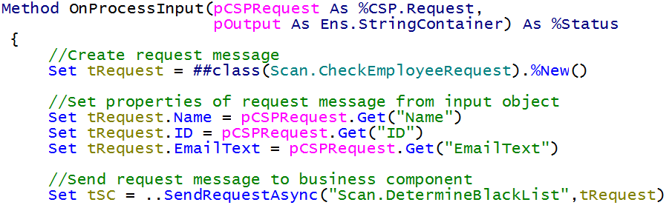
Ensemble 开发 业务服务(BS)
Notes:
Synchronous calls are not typically used since they tie up the business service from processing other requests. A business service should accept the input and then asynchronously call a business process or business operation for processing and fulfillment.
Most requests are asynchronous.
Although a request can be asynchronous or synchronous, only a synchronous request can have a response.
A business service does not maintain state and is not persistent, so it cannot receive an asynchronous response.
A response can be received from a synchronous call since it does not require state and persistence.
If you need to receive a response, it is better to send the input request to a business process than use an synchronous call from a business service. This is better than a synchronous call from the business service, since synchronous calls are not recoverable.
SendRequestSync() needs to pass the response by reference.
ObjectScript does not pass by reference by default. ISC Basic does pass by reference by default.

Slide 6
Ensemble 开发 业务服务(BS)
ProcessInput().
Part of Ensemble.
OnProcessInput().
Must be implemented.
Business
Service
Business
Process
Client Application
ProcessInput()
Adapter
OnProcessInput()
Notes:
ProcessInput() is the method used by an adapter or client application to invoke a business service.
ProcessInput() will call OnProcessInput() to process the input.
Every business service must have an OnProcessInput() method.
This method is called as a result of a business service receiving input.
The outline of OnProcessInput() is:
Create a new request message.
Set the properties of the request based on the input object.
Send the request to a business process (or business operation) using SendRequsetSync() or SendRequestAsync().
A client application that wants to directly invoke a business service needs to do the following:
Call CreateBusinessService(). This creates an instance of the business service.
Call ProcessInput() for that business service.
Details can be found in Chapter 4: Business Services, in Creating Ensemble Productions.
An example of this can be found in the CSP page <installdir>/csp/ensemble/DemoLoanSubmit.csp.
For more details on adapters, refer to Chapter 3: Inbound Adapters, in Developing Ensemble Applications.

Slide 7
Ensemble 开发 业务服务(BS)
Pool Size:
对于无Adaptor的BS
始终设置为0，因为这些BS是由外部应用直接调用的
对于有Adaptor的BS
如果设置为0，则不会运行

Slide 8
Ensemble 业务服务 (Business Services)-Web Service

Slide 9
Ensemble对于Web Service的支持
Web Service
Client
Business
Operation
Outbound Adapter
Inbound Adapter
Web Service
Business
Services
Ensemble
Application
Ensemble

Slide 10
Ensemble对于Web Service的支持
Ensemble 支持SOAP 1.1以及1.2 (Simple Object Access Protocol) 以及REST (Representational State Transfer).
发送XML消息通过 HTTP 或者 HTTPS.
原生支持，不使用任何中间件
Ensemble web service clients.
Business Operations通过SOAP或者REST与外部web services通讯
Ensemble web services.
Business Services允许外部客户端通过SOAP或者REST与Production通讯

Slide 11
SOAP Web Service 工具
Client Tools:
Studio SOAP Client Wizard.
通过外部WS的WSDL自动生成Business Operation一级代理类。
Service Tools:
自动产生WSDL
Web service测试页面

Slide 12
Ensemble Web Service Clients
Client Applications
Inbound Adapters
Business
Services
Business
Operations
Outbound Adapters
External Applications
Business
Processes
Ensemble

Slide 13
Ensemble SOAP Web Service Clients
Business Operations.
继承于Ens.BusinessOperation.
使用EnsLib.SOAP.OutboundAdapter.
内置HL7Business Operation类，以及pass-through或者用户自定义
使用Studio SOAP Client Wizard.

Slide 14
Ensemble SOAP Web Service Clients
EnsLib.SOAP.
OutboundAdapter
Business Operation
Method AMethod(…){
…
Set ..Adapter.WebServiceClientClass
= "Class1"
Do ..Adapter.InvokeMethod("Method1",
…)
…
}
Property WebServiceClientClass;
Method InvokeMethod()
Proxy Classes
Web
Service
Class1
SOAP Request
Method1()
SOAP Response

Slide 15
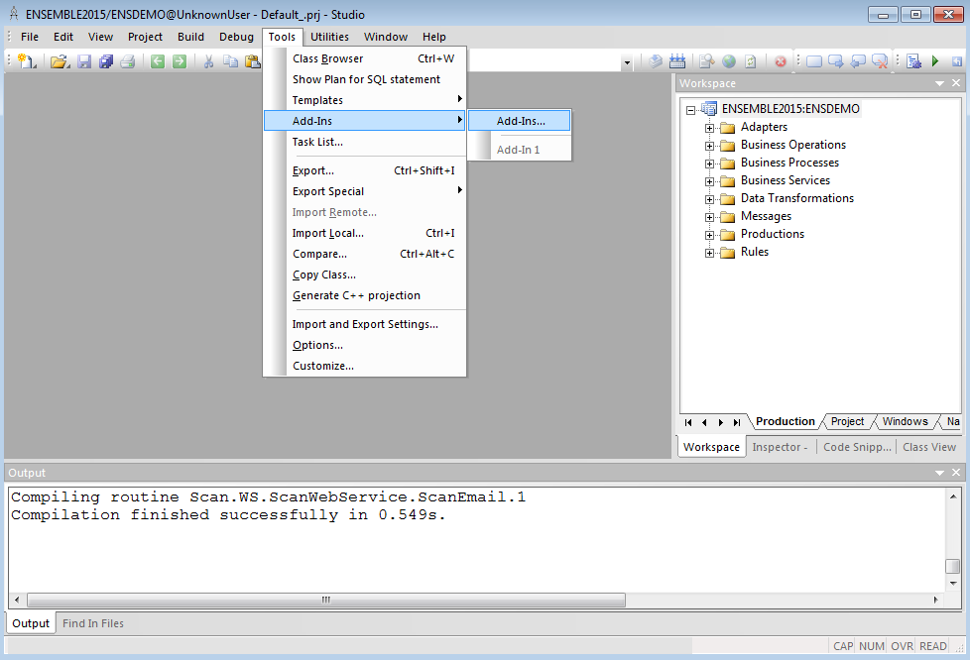
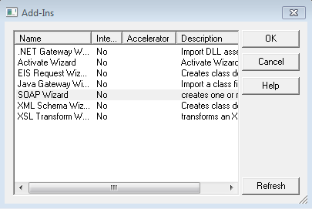
SOAP Client 向导
Tools → Add-Ins → Add-Ins.
SOAP client wizard.

Slide 16
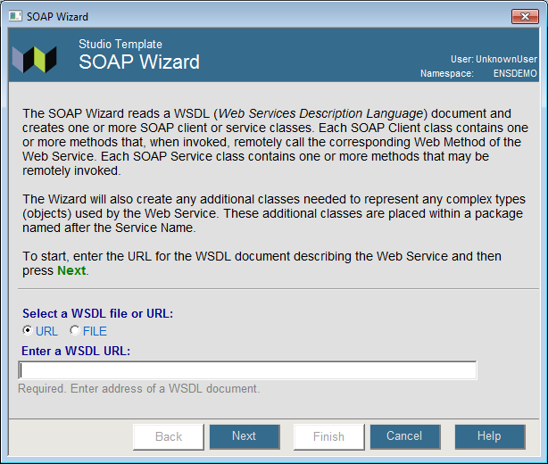
SOAP Client 向导
web service WSDL的URL

Slide 17
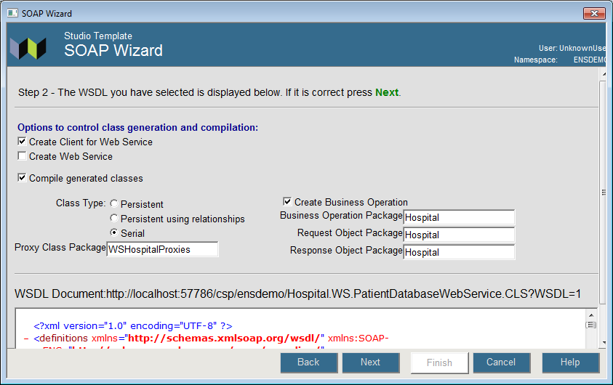
SOAP Client Wizard向导
勾选Create Business Operation.
Business Operation以及 messages的包名
代理类包名

Slide 18
配置
添加Business Operation 到 Production 并配置.
Setting | Description
Web Service URL | 如果在代码中没有指明WS的地址
Web Service Client Class | 代理类名称
SOAP Credentials | Ensemble 用户名密码对，用于 WS-Security header头中的对应内容。
Credentials | Not used.
SSL Config | SSL/TLS 系统配置名

Slide 19
Ensemble Web Services
Client Applications
Inbound Adapters
Business
Services
Business
Operations
Outbound Adapters
External Applications
Business
Processes
Ensemble

Slide 20
Ensemble SOAP Web Services
Business Services.
继承于EnsLib.SOAP.Service.
提供web方法可被外部系统访问调用。
接收SOAP request消息
返回SOAP response消息
提供 OnProcessInput().
在Production内部发送request消息
在Production内部接收response消息
内置HL7Business Service类，以及pass-through或者用户自定义

Slide 21
Ensemble SOAP Web Services
Business Service
Extends EnsLib.SOAP.Service
SOAP Request
SOAP Response
MyWebMethod() [WebMethod]
ProcessInput()
Ensemble Request
OnProcessInput()
Ensemble Response

Slide 22
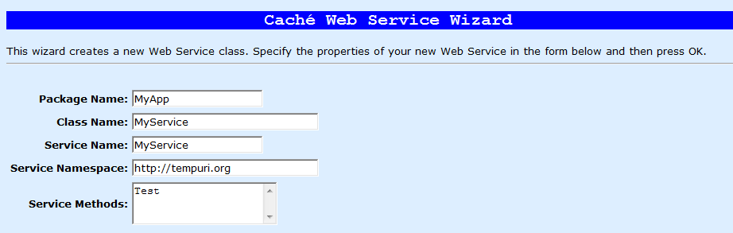
创建Web Service
在Studio中
使用Caché Web Service wizard.
集成于EnsLib.SOAP.Service替换原有的 %SOAP.WebSerivce.
使用Caché Class Definition wizard.
继承于EnsLib.SOAP.Service

Slide 23
Web Service 实现
实现web方法.
标识[WebMethod].
接收SOAP request.
引用 ProcessInput().
返回 SOAP response.
实现 OnProcessInput().
从web方法接收数据
创建和发送Ensemble message.
把返回的值返回给web method.

Slide 24
Web Service实现
Parameters.
ADAPTER:
设置为””将可以使用通用的调用web server方法
设置为n默认值EnsLib.SOAP.InboundAdapter，可以通过客户自定义端口号调用。
NAMESPACE:
XML namespace不是 Ensemble namespace.
SERVICENAME:
web service的名字

Slide 25
Error 处理
在web method中通过ProcessInput()返回的status code。
使用下面的方法产生SOAP Fault messages:
ReturnMethodStatusFault(pStatus As %Status)
使用通用的error code.
ReturnStatusFault(pCode As %String, pStatus as %Status)
pCode可以是用户自定义错误代码

Slide 26
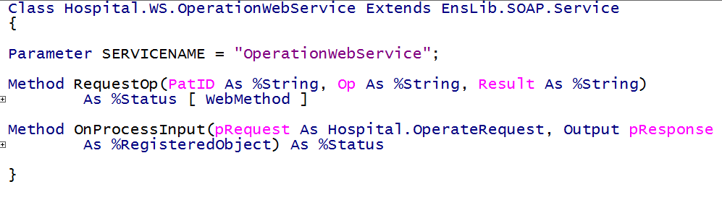
Business Service 类
Parameters.
Web method.
OnProcessInput().

Slide 27
配置
添加到Production中并配置
Setting | Request through Web Server (typical) | Request through Custom Port
Name | Must be class name. | Customizable.
Pool Size | 0 | >0
Enable Standard Requests | True to allow requests through web server. | False (default).
Port | Does not apply. | Port to listen for SOAP requests.
Adapter | Does not apply. | EnsLib.SOAP. InboundAdapter.
SSL Config | Name of existing SMP SSL/TLS system configuration.

Slide 28
Request Through Web Server
If EnsLib.SOAP.InboundAdapter associated with web service:
Make Pool Size = 0.
Will not listen on SOAP port.
Cannot accept requests through SOAP port.
If Pool Size > 0:
Can accept requests through SOAP port as well.
Adapter port must be unique to Business Service.
Gives error if port being used by another Business Service in Production since listens on adapter port.

Slide 29
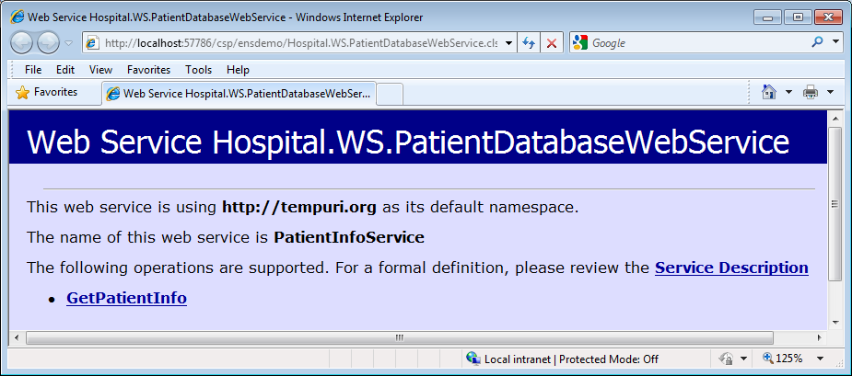
Test Page and WSDL
打开测试界面:
URL：
http://localhost:57777/csp/namespace/（class name of the web service）.cls
允许测试：
%SYS>s ^SYS("Security","CSP","AllowClass","/csp/huangshiens/","%SOAP.WebServiceInvoke")=1
浏览 WSDL.
测试服务.

